Slide 1


ORAIMO SALES FORECASTING
By: Everything Data

Slide 2
Team Members
Calvince Kaunda
Samuel Marimbi
Peter Nyakundi
Sanayet Sankaine
Gloryann Otieno

Slide 3



Business Understanding
Brand Growth
Product Range
Oraimo, Africa’s leading smart-accessories brand since 2013.
Includes earbuds, power banks, and personal care devices.
Competitive Edge
Affordable pricing, loyalty rewards, after-sales support, and influencer marketing.

Slide 4



Business Problem
Inconsistent Sales
Forecasting Need
Sales fluctuate by product and region, resulting in inefficiencies and revenue loss.
Accurate forecasting is essential to optimize inventory management and budget allocation.

Slide 5
Objectives
Forecasting Model
Performance Evaluation
Actionable Insights
Dashboard Creation
Build a model to predict sales for October 2024.
Support financial planning and resource allocation.
Develop a forecasting visualization tool.
Identify top cities and products.

Slide 6
Metrics of Success
To achieve stationarity using Dicky Fuller test with a p-value of less than 0.05.
To achieve a forecasting model with RMSE and MAE < One Million Shillings a day.

Slide 7

Stakeholders
Audience
Gains / Benefits
Oraimo Management Team
Strategic planning and informed decisions
Sales Team
Aligned sales targets with revenue forecasts
Finance Team
Accurate budgeting and cash flow management
Retailers & Shop Managers
Optimized stock for demand surges
Data & Business Analysts
Model development and monitoring

Slide 8
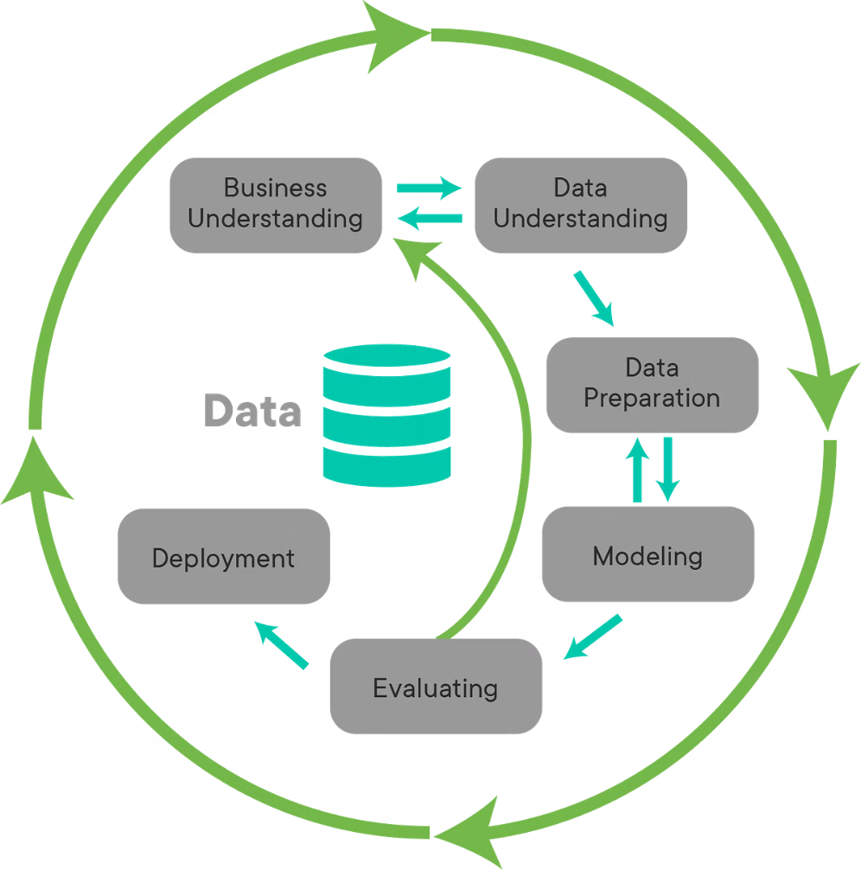
Approach
We applied a streamlined methodology using time series forecasting techniques tailored for Oraimo's sales data.

Slide 9

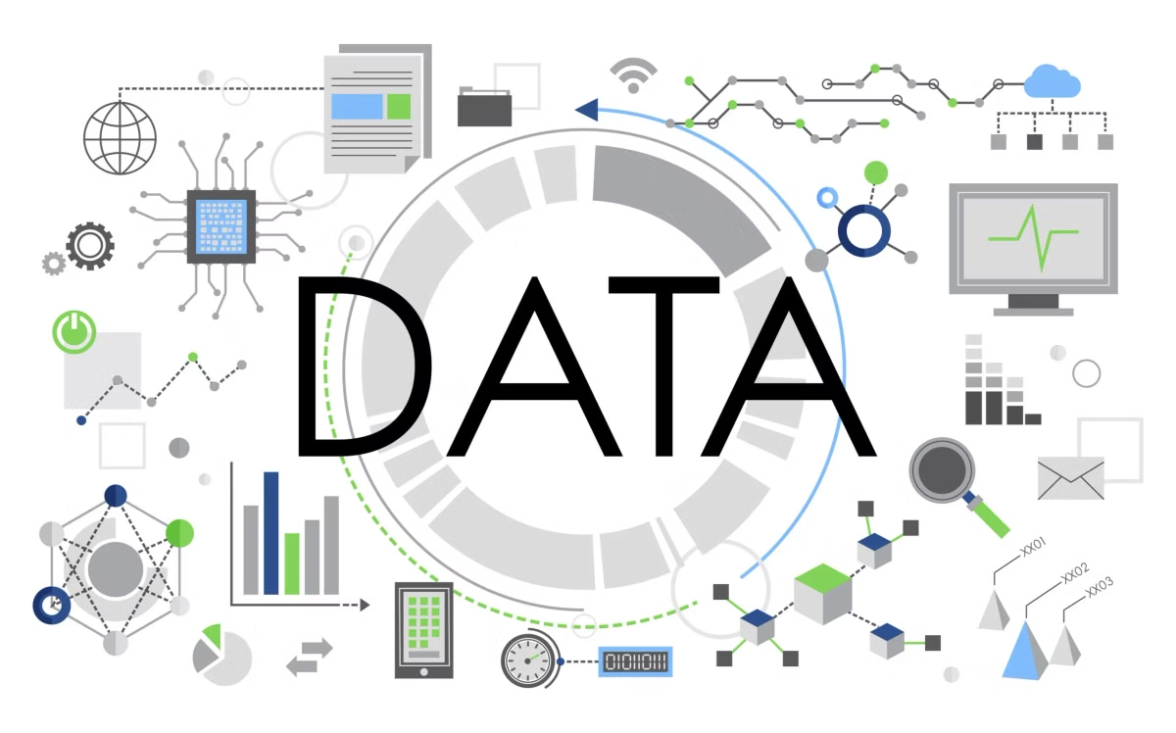
Data Understanding and Preparation
Data Source
Models are based on the Oraimo sales dataset from DataVerse
Dataset Overview
19,802 sales records from January to October 2024.
Data Cleaning
Handled missing, duplicates, standardized columns, and indexed by date.
Data preparation
Grouped products into five categories for analysis.

Slide 10





Exploratory Data Analysis
Identify Patterns
Analyze sales trends and seasonality.
Detect Outliers
Recognize anomalies affecting sales figures.
Model selection
Guide our decisions on variables for modeling.

Slide 11

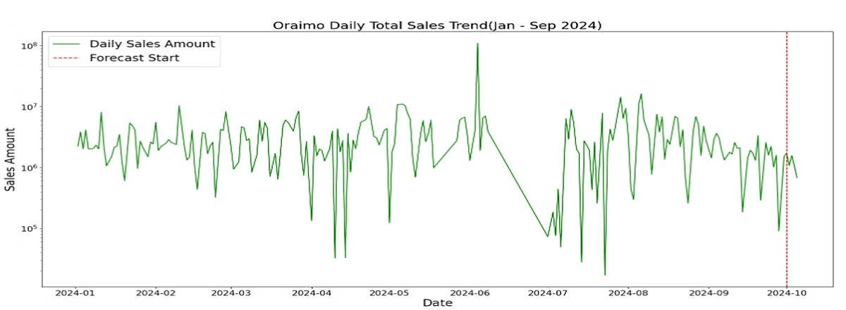
TOTAL DAILY SALES TREND
Significant daily fluctuation in sales amounts throughout the period indicate there are no seasonal/ cyclic patterns. This indicates the need for a time series model that captures irregular patterns rather than relying on cyclic trends

Slide 12
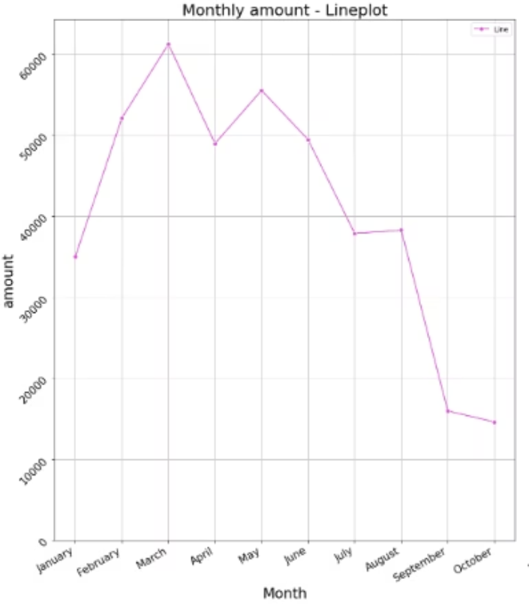
AVERAGE MONTHLY SALES
Sales typically peak in March and May, likely due to seasonal demand or special events. March had the most average sales if 60,000. May had an average sales figure of 55,000. After May sales steadily decrease, hitting a low in October.
These fluctuations in customer purchasing behaviors may be driven by external factors such as promotions, seasonality or product availability

Slide 13

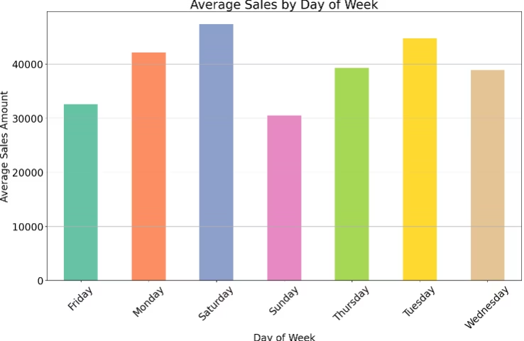
AVERAGE SALES BY DAY OF THE WEEK
Sunday had the lowest sales, while Saturday has the most with more than 40,000 in revenue on Saturdays
Midweek surges point to early week purchasing enthusiasm that may be used for focused marketing campaigns

Slide 14

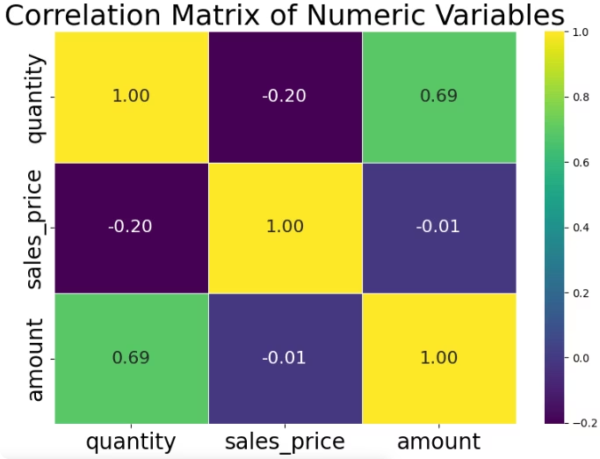
CORRELATION MATRIX OF NUMERIC VAIABLES
Quantity and Amount: A strong positive correlation of 0.69 indicates an increase in quantity of goods sold results in an increase in sales amount/revenue
Sales Price and Amount: A weak negative correlation of -0.01 suggests that there is virtually no relationship between sales price and the total amount

Slide 15

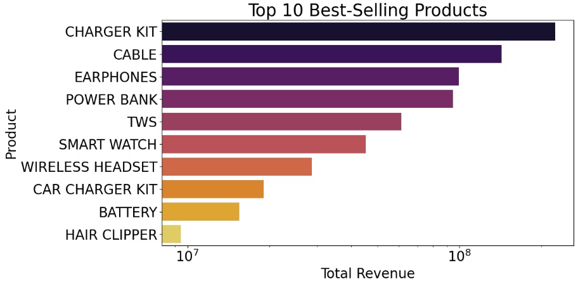
BEST SELLING PRODUCTS
Charger Kits and cables are the clear revenue leaders, with a noticeable drop off in sales for subsequent products. Charger kits generate more up to 180Million in total revenue while cables and earphones each generate 100Million in total revenue.
Hair clippers and batteries are the lowest revenue generators with a total revenue of at least 1Million each indicating there is a strong demand for charging accessories as compared to other products

Slide 16

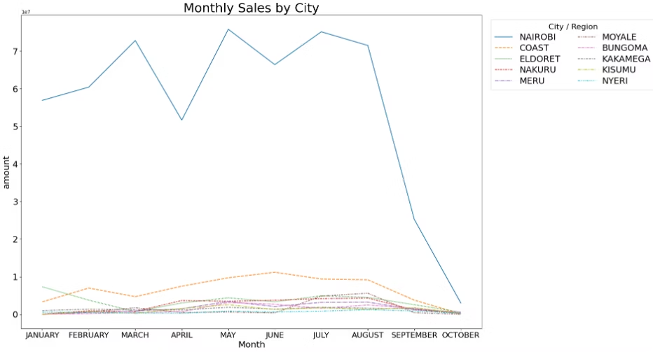
SALES PER CITY
Nairobi dominates with monthly sales peaking at Ksh7Million in March and May —far above every other city.
The graph highlights strong regional differences in sales performance, with Nairobi significantly outperforming all other cities. There is a clear seasonal trend suggesting optimal windows for promotions and restocking.

Slide 17
Modelling
The following models were trained and tested on the dataset:
Baseline Models: Moving Average, Simple Naïve Forecast
Classical Time Series: SARIMA
Machine Learning: Random Forest, XGBoost
Advanced Models: Light GBM, Prophet
Deep Models: LSTM

Slide 18

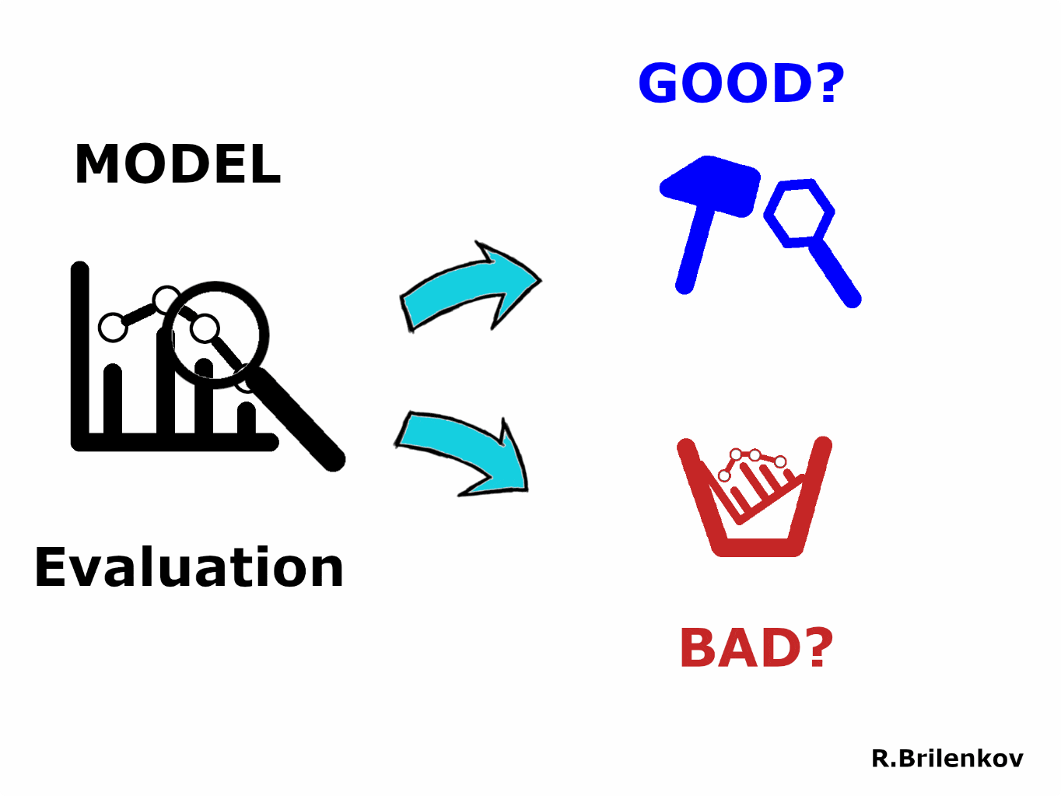
Model Evaluation
MODEL
MAE (ksh)
RMSE (ksh)
Random Forest
556,230
821,709
LightGBM
702,432
887,816
XGBoost
768,637
1,058,715
Naive Baseline
1,400,624
1,626,283
Moving Average
2,116,034
2,330,971
LSTM
2,140,613
2,172,117
Prophet
2,166,699
2,740,919
SARIMA
2,292,082
2,996,742
The best performing models were Random Forest and XGBoost.
They captured complex patterns more effectively than models that relied on assumptions of seasonality or trends such as SARIMA
Lag features and rolling statistics allowed the Tree based models to learn patterns more effectively

Slide 19

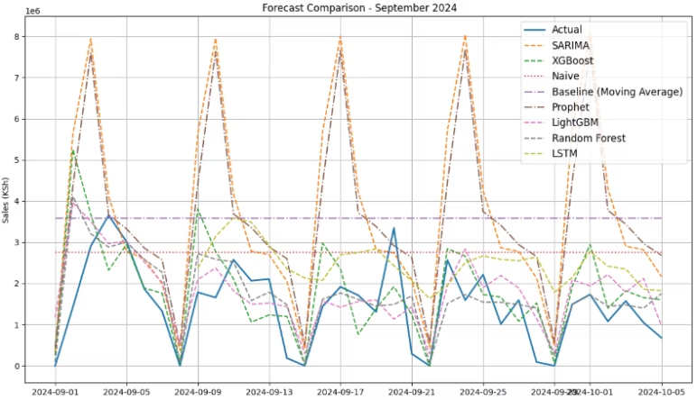
SEPTEMBER FORECAST
Tree based models such as XGBoost and Random Forest should be used for forecasting as they mirror sales trends most accurately and report the lowest MAE.
They are the most accurate

Slide 20

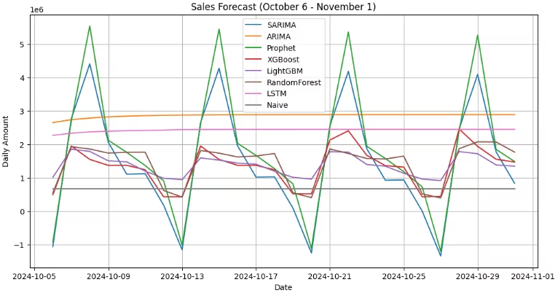
OCTOBER FORECAST
Random Forest(Brown), XGBoost(Red) and LightGBM(Purple) which showed better ability to track actual sales in September also predict considerable daily volatility in October, Prophet and SARIMA have extreme peaks and troughs , a pattern consistent with September predictions

Slide 21

This forecasting solution helps Oraimo anticipate future demand with greater accuracy enabling for smarter business decisions
Real world use cases:
Sales and revenue forecasting
Market Timing
Resource Allocation

Slide 22
CONCLUSION
We tested different methods to predict Oraimo’s daily sales. These included simple approaches like averaging past sales, traditional statistical methods, machine learning models, and even deep learning (AI).
Among them, the tree-based models like XGBoost and Random Forest gave the most accurate results—much better than the basic methods, improving accuracy by over 25%.
The LSTM model, which uses deep learning, also did really well and gave smooth, realistic sales predictions.
Prophet, another advanced tool, didn’t perform as expected and often predicted too many sales, meaning it needs more fine-tuning.

Slide 23

Classical time series models aren’t always sufficient.
Tree based ensemble models delivered best results.
LSTM produced smooth forecasts but required more data and tuning
Data preparation is critical

Slide 24






Plan using 4-week forecasts
Optimize stocking for weekends
Use 4-week sales forecasts to time promotions, product launches, and budget planning more effectively
Leverage forecasts to adjust reorder points, especially ahead of high-demand weekends e.g restock mid week to prepare for spikes
Align Budgets with demand
Adjust Stock levels proactively
Use predicted demand to plan inventory and purchasing budgets, helping to optimize cash flow and avoid overstocking or understocking
Base stock adjustments on upcoming demand forecasts to ensure timely replenishment if fast-moving products

Slide 25

Next Steps
1
Ensemble Stacking
Create a single model of our best models, Random Forest and XGBoost in order to get the best patterns and improve accuracy
2
Holidays and campaign data
Take in a CSV or API feed of local holidays and promotional campaigns from an external source
3
Performance monitoring
Record daily forecasts vs actual mistakes in a database or CSV file. Expand data to include recent dates by incorporating present data

Slide 26
DEMO
The final XGBoost regression model was deployed as an interactive web app to enable real-time forecasting of future sales based on engineered features
A lightweight front-end interface was developed using Streamlit
Users enter recent sales and calendar info like date or weekend, and it predicts upcoming sales
The application was hosted using ngrok which provides a secure public URL for accessing the web app

